Slide 1
WEEK 3
Data Cleaning II + Real Dataset
Production-ready cleaning with outliers, strings, dates, and full pipelines
Day 11
Outlier Strategies
Capping, flooring, removal, model sensitivity
Day 12
String & Date Cleaning
Text normalization, datetime parsing, time zones
Day 13
Large Dataset Cleaning
Chunking, sampling, vectorization, performance
Day 14
Full Cleaning Pipeline
Modular design, order of operations, validation
Day 15
Mini Project
End-to-end cleaning of real messy dataset
BASE DATA SETUP
import numpy as np, pandas as pd, matplotlib.pyplot as plt, seaborn as sns
np.random.seed(42)
# Simulate heavy-tailed income with extreme outliers

Slide 2
DAY 11
Outlier Strategies
Capping, Flooring, Removal, and Model Impact
OBJECTIVES
ACTIVITY
• Review outliers and how they arise
• Implement capping (winsorization) and flooring
• Use percentiles and IQR for thresholds
• Visualize before/after with boxplots
• Reason about when NOT to remove outliers
Implement 99th percentile capping function.
Apply to real feature and visualize before/after.
ASSESSMENT
Notebook with code, boxplots, and written justification for chosen strategy.
Week 3 · Data Cleaning II

Slide 3
DAY 11 · OUTLIER STRATEGIES
Outliers in Real Datasets — Brief Review
Not automatically bad data - may be critical signals
Outlier Sources
Why 'Just Remove Big Values' Fails
• True extreme values (startup exit, large hospital bill)
• Data-entry mistakes (extra zero in salary)
• System artifacts (duplicate aggregation, unit conversion errors)
• Extremes may be most informative (fraud, default risk)
• Removal shifts means, variances, decision boundaries
• Outliers may represent specific subgroups → unfairness
VISUALIZING WITH BOXPLOT
income = np.concatenate([np.random.lognormal(10, 0.5, 5000), [1e7, 2e7, 5e7]])
df11 = pd.DataFrame({"income": income})
plt.figure(figsize=(6,4)); sns.boxplot(x=df11["income"])
plt.xscale("log"); plt.title("Income Distribution with Outliers")

Slide 4
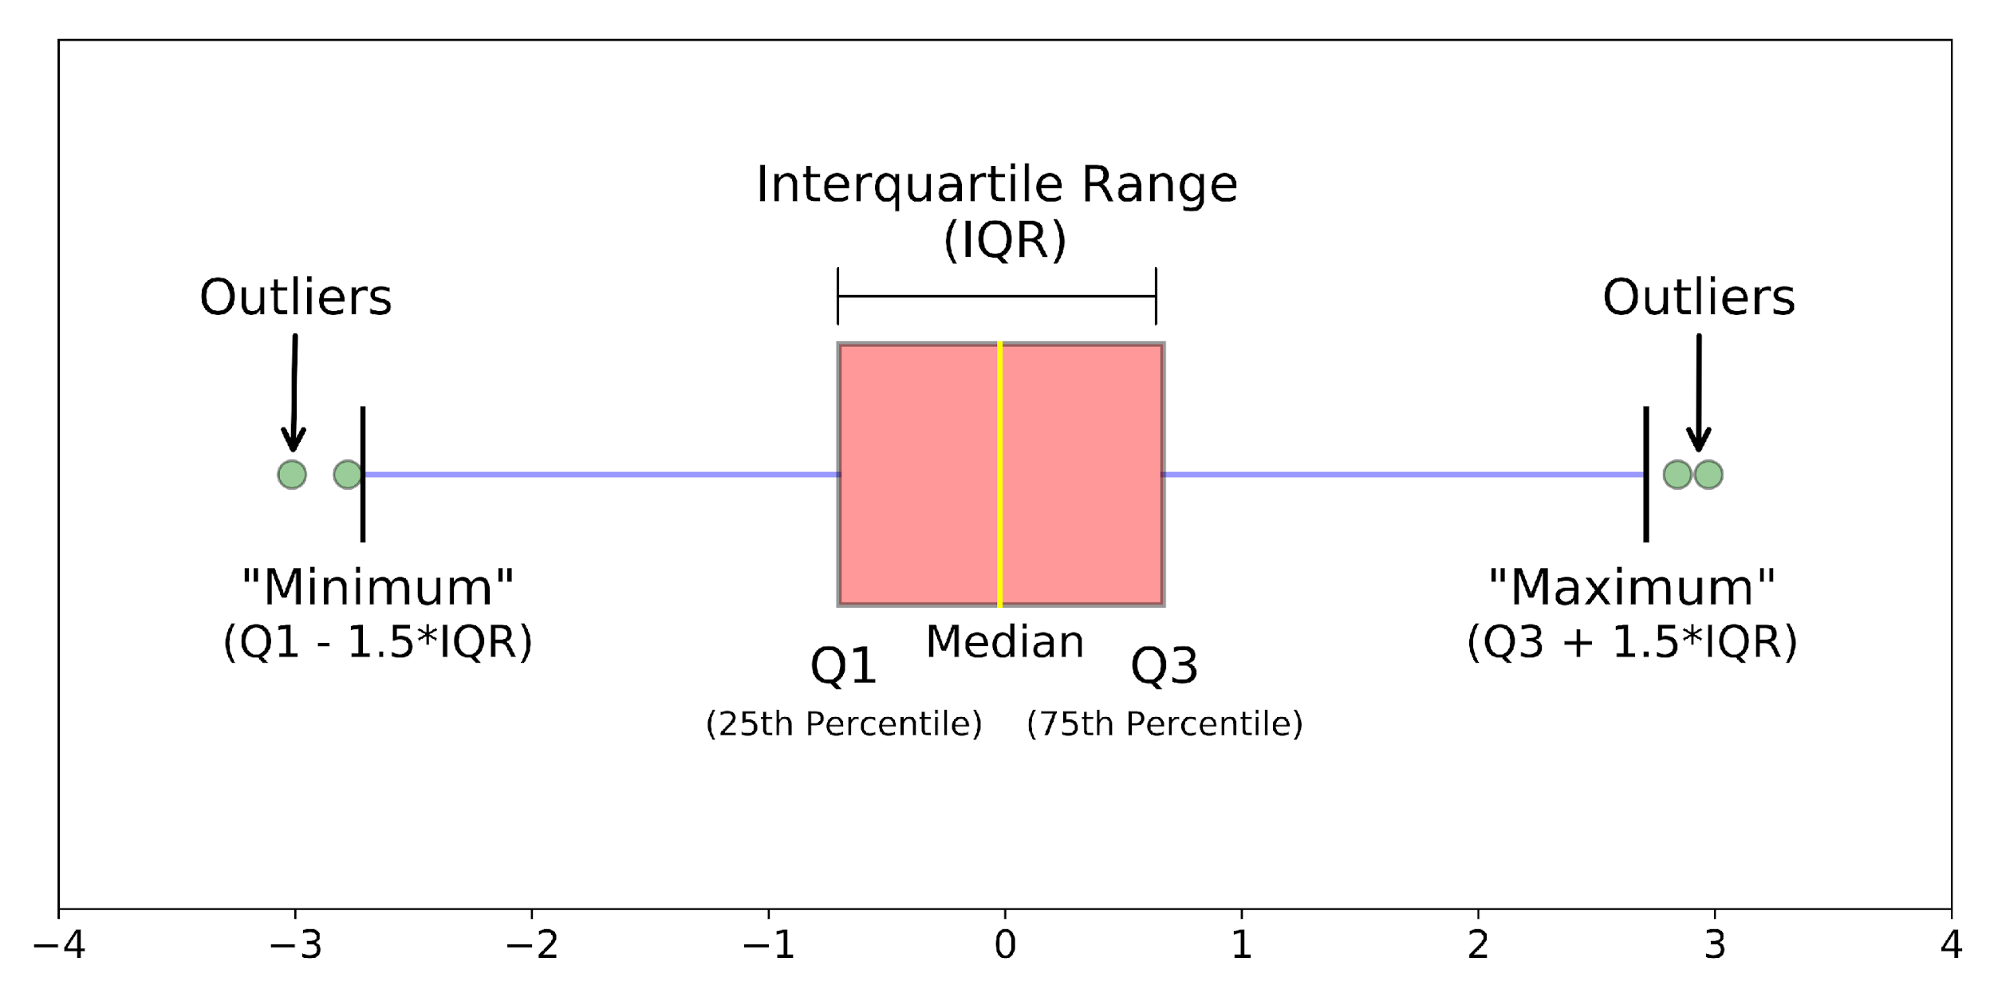
DAY 11 · OUTLIER STRATEGIES
Capping Outliers (Winsorization)
Replace extreme values with percentile thresholds
Real-World Motivation
When Capping Is Reasonable
• Extremely large values distort loss functions (squared error)
• Rather than discard, cap to limit leverage
• Keeps all records but reduces extreme influence
• Tails are real but shouldn't dominate
• Goal is robust prediction, not precise tail estimation
• Sample size is limited
WINSORIZATION AT 1ST AND 99TH PERCENTILES
def winsorize_series(s: pd.Series, lower_q=0.01, upper_q=0.99) -> pd.Series:
lower, upper = s.quantile(lower_q), s.quantile(upper_q)
return s.clip(lower=lower, upper=upper)
df11["income_cap_1_99"] = winsorize_series(df11["income"], 0.01, 0.99)

Slide 5
DAY 11 · OUTLIER STRATEGIES
Flooring and Asymmetric Capping
Different thresholds for lower and upper bounds
Use Cases
Asymmetric Strategy
• Negative values impossible by domain (negative counts)
• Very small positives = sensor noise, not real signal
• Asymmetric distributions where only one tail problematic
Different quantiles for lower/upper
(e.g., 5th percentile floor, 99.5th cap)
Risk: aggressive flooring may obscure economically
vulnerable groups
ASYMMETRIC CAPPING WITH .clip()
def asymmetric_cap(s: pd.Series, lower_q=0.05, upper_q=0.995) -> pd.Series:
lower, upper = s.quantile(lower_q), s.quantile(upper_q)
return s.clip(lower=lower, upper=upper)
df11["income_cap_asym"] = asymmetric_cap(df11["income"], 0.05, 0.995)

Slide 6
DAY 11 · OUTLIER STRATEGIES
Removal Strategy — When Dropping Is Appropriate
Most aggressive - eliminates extreme rows entirely
Appropriate Scenarios
Inappropriate Scenarios
• Confirmed data-entry errors (salary 1B when max is 1M)
• Obvious system artifacts (duplicated aggregation, corrupted records)
• Rare but legitimate high-impact events (ICU stays,
large purchases)
• Small datasets where every row matters
• Risk: model blind to critical regimes
REMOVAL USING PERCENTILE MASK
upper_99 = df11["income"].quantile(0.99)
mask_keep = df11["income"] <= upper_99
df11_removed = df11[mask_keep].copy()
print("Original rows:", len(df11), "After removal:", len(df11_removed))

Slide 7
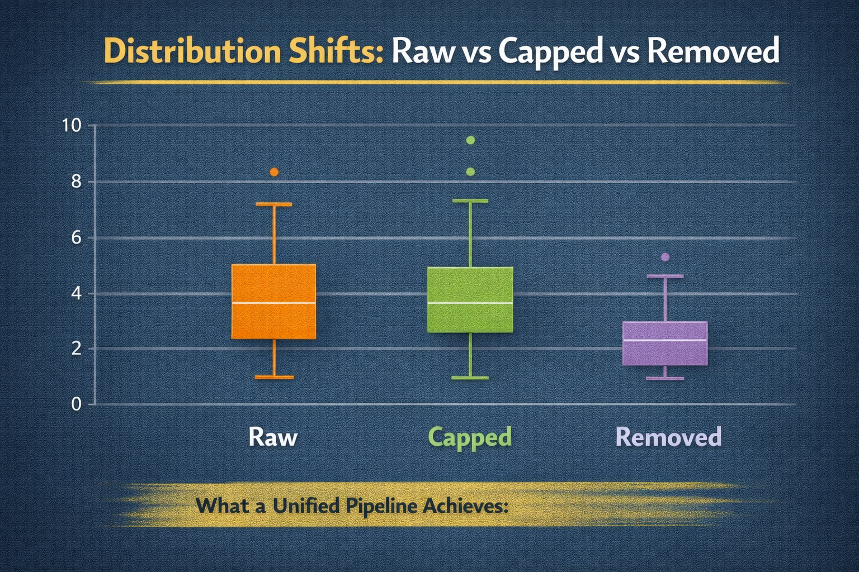
DAY 11 · OUTLIER STRATEGIES
Visual Comparison of Capping vs Removal
Boxplots reveal shifts in quartiles and tails
What to Look For
Interpretation
• How far whiskers extend after treatment
• Whether central bulk (IQR) is significantly altered
• Whether many points cluster at cap boundary
• Raw: long whiskers, extreme outliers
• Capped: whiskers truncated, same N
• Removed: shorter whiskers, reduced N
BOXPLOTS FOR RAW, CAPPED, AND REMOVED
data_to_plot = [df11["income"], df11["income_cap_1_99"], df11_removed["income"]]
labels = ["Raw", "Capped (1-99%)", "Removed (>99%)"]
plt.figure(figsize=(8,4)); sns.boxplot(data=data_to_plot)
plt.xticks(range(len(labels)), labels); plt.xscale("log")

Slide 8
DAY 11 · OUTLIER STRATEGIES
ML Model Sensitivity to Outlier Strategies
Different models respond differently to extreme values
Linear/Logistic
Tree-Based
Regularization
Highly sensitive due to squared/log loss
Outliers → large gradients, unstable parameters
More robust but still affected
Splits may focus on rare extremes
L1/L2 partially mitigates but doesn't fix underlying data
LOGISTIC REGRESSION WITH/WITHOUT CAPPING
from sklearn.linear_model import LogisticRegression
threshold = df_model["income"].quantile(0.9)
df_model["target"] = (df_model["income"] >= threshold).astype(int)
clf_raw = LogisticRegression().fit(X_raw, y); clf_cap = LogisticRegression().fit(X_cap, y)
print("Coef raw:", clf_raw.coef_[0][0], "Coef capped:", clf_cap.coef_[0][0])

Slide 9
DAY 11 · OUTLIER STRATEGIES
When NOT to Remove or Cap Outliers
Sometimes extremes ARE the signal
Domains Where Extremes Matter
Alternative Strategies
• Fraud detection: rare high-value fraudulent transactions
• Risk modeling: catastrophic failures, defaults
• Medical outcomes: rare severe complications
• Use robust loss functions (Huber loss)
• Model tails separately (two-stage modeling)
• Weight rare events appropriately
IDENTIFYING TAIL FOR SPECIAL TREATMENT
high_tail = df11["income"] >= df11["income"].quantile(0.995)
df_tail = df11[high_tail]
df_main = df11[~high_tail]
print("Tail count:", len(df_tail), "Main count:", len(df_main))

Slide 10
DAY 11 · OUTLIER STRATEGIES
Implementing a 99th Percentile Capping Function
Reusable function for production pipelines
Requirements
Extensions
• Percentile thresholds computed from data
• Ability to cap only upper tail, or both
• Clear documentation of chosen percentiles
• Return thresholds for logging/reproducibility
• Add lower_q parameter for two-sided capping
• Return both capped series and thresholds
• Support column-wise application
FUNCTION THAT CAPS AT 99TH PERCENTILE
def cap_at_percentile(s: pd.Series, upper_q: float = 0.99) -> pd.Series:
"""Cap values in a numeric series at a given upper percentile."""
upper = s.quantile(upper_q)
return s.clip(upper=upper)
df11["income_cap_99"] = cap_at_percentile(df11["income"], upper_q=0.99)

Slide 11
DAY 11 · ACTIVITY & ASSESSMENT
Outlier Capping Practice
Implement and visualize capping strategies
Activity Steps
Assessment
1. Load real numeric column (e.g., transaction amount)
2. Plot boxplot and histogram (consider log-scale)
3. Implement cap_at_percentile at 99th
4. Apply to feature, create capped column
5. Plot before/after boxplots on same scale
6. Compare summary stats (mean, median, std)
Conceptual:
• Difference between winsorization and removal?
• When is 99th percentile harmful vs helpful?
Code: Implement cap_outliers(df, column, upper_q) that prints threshold and fraction capped.
SKELETON
df_real["amount_capped"] = cap_at_percentile(df_real["amount"], 0.99)
fig, axes = plt.subplots(1, 2); sns.boxplot(x=df_real["amount"], ax=axes[0])
sns.boxplot(x=df_real["amount_capped"], ax=axes[1])

Slide 12
DAY 12
String & Date Cleaning
Text Normalization and Datetime Handling
OBJECTIVES
ACTIVITY
• Clean and normalize user-entered text
• Standardize categories to canonical forms
• Parse heterogeneous date formats
• Localize naive datetimes to time zones
• Understand pitfalls of naive datetime handling
Clean and standardize city column and timestamps.
ASSESSMENT
Code with cleaned text/dates, plus written explanation of decisions.
Week 3 · Data Cleaning II

Slide 13
DAY 12 · STRING & DATE CLEANING
Messy User-Entered Text
Whitespace, case, and noise create spurious categories
Typical Problems
Why Basic Cleaning Is Insufficient
• Leading/trailing whitespace: ' new york' vs 'new york '
• Inconsistent case: 'NEW YORK' vs 'new york'
• Embedded punctuation: 'san-francisco', 'San Francisco!'
• Abbreviations: 'nyc', 'NY', 'N.Y.'
• Case normalization doesn't resolve synonyms
• Naive replacement rules can merge distinct categories
• Without explicit mapping, model sees many rare categories
BASIC WHITESPACE AND CASE NORMALIZATION
df12 = pd.DataFrame({"raw_city": [" new york", "New york ", "NEW YORK", "nyc", "NYC"]})
df12["city_clean_basic"] = (
df12["raw_city"].str.strip().str.lower() # Remove whitespace, lowercase
)
print(df12[["raw_city", "city_clean_basic"]])

Slide 14

DAY 12 · STRING & DATE CLEANING
Removing Special Characters and Normalizing Separators
Hyphens and punctuation create artificial categories
Problems
Risks
• 'san-francisco' vs 'San Francisco' = distinct values
• 'London!' pollutes category space
Strategy: Replace separators with spaces, remove non-letters
• Over-aggressive removal (diacritics, non-Latin) can erase meaningful distinctions
• Always validate against domain requirements
NORMALIZING WITH .str AND REGEX
df12["city_clean_sep"] = (
df12["city_clean_basic"]
.str.replace("-", " ", regex=False) # Hyphens to spaces
.str.replace(r"[^a-z\s]", "", regex=True) # Keep only letters and spaces
.str.replace(r"\s+", " ", regex=True).str.strip() ) # Collapse multiple spaces

Slide 15
DAY 12 · STRING & DATE CLEANING
Standardizing Categories — Mapping to Canonical Values
Explicit mapping for synonyms and abbreviations
Example Mapping
Risks
• 'new york', 'nyc', 'ny' → 'new york'
• 'san francisco', 'sanfrancisco' → 'san francisco'
Without mapping: sparse one-hot, unstable models
• Incorrect mappings (e.g., 'ny' for 'New Year' code)
• Must validate against domain knowledge
• Document all mappings for auditability
MAPPING USING .replace OR .map
canonical_map = {"new york": "new york", "nyc": "new york", "ny": "new york",
"san francisco": "san francisco", "sanfrancisco": "san francisco"}
df12["city_token"] = df12["city_clean_sep"].str.replace(" ", "", regex=False)
df12["city_canonical"] = df12["city_token"].map(canonical_map).fillna(df12["city_clean_sep"])

Slide 16
DAY 12 · STRING & DATE CLEANING
Heterogeneous Date Formats — Parsing to Datetime
Real datasets have multiple date formats
Common Issues
Strategy
• Mix of ISO ('2024-01-01'), slashed ('01/01/2024')
• Day-first vs month-first ambiguity ('04/05/2024')
• Mixed separators (-, /, T)
• Timestamps with varying precision
• Use pd.to_datetime(errors='coerce')
• Inspect NaT count after parsing
• Use dayfirst parameter where appropriate
INITIAL PARSING ATTEMPT
df12["raw_signup"] = ["2024-01-01 10:00", "01/01/2024 15:00", "2024/01/01"]
df12["signup_dt_raw"] = pd.to_datetime(df12["raw_signup"], errors="coerce", infer_datetime_format=True)
print(df12[["raw_signup", "signup_dt_raw"]])
print("NaT count:", df12["signup_dt_raw"].isna().sum())

Slide 17
DAY 12 · STRING & DATE CLEANING
Handling Ambiguous Date Formats and Locale Issues
'04/05/2024' may mean April 5 or May 4
Strategy
Risks
• If source locale known, use dayfirst or format string
• Otherwise, mark ambiguous as missing
• Separate US-style and ISO-like dates with masks
• Guessing locale incorrectly shifts dates by months
• Silently breaks seasonality features
• Can corrupt model calibration entirely
SEPARATING US-STYLE AND ISO DATES
us_mask = df12["raw_signup"].str.contains(r"\d{2}/\d{2}/\d{4}", regex=True)
iso_mask = ~us_mask
df12.loc[iso_mask, "signup_dt"] = pd.to_datetime(df12.loc[iso_mask, "raw_signup"], errors="coerce")
df12.loc[us_mask, "signup_dt"] = pd.to_datetime(df12.loc[us_mask, "raw_signup"], errors="coerce", dayfirst=False)

Slide 18
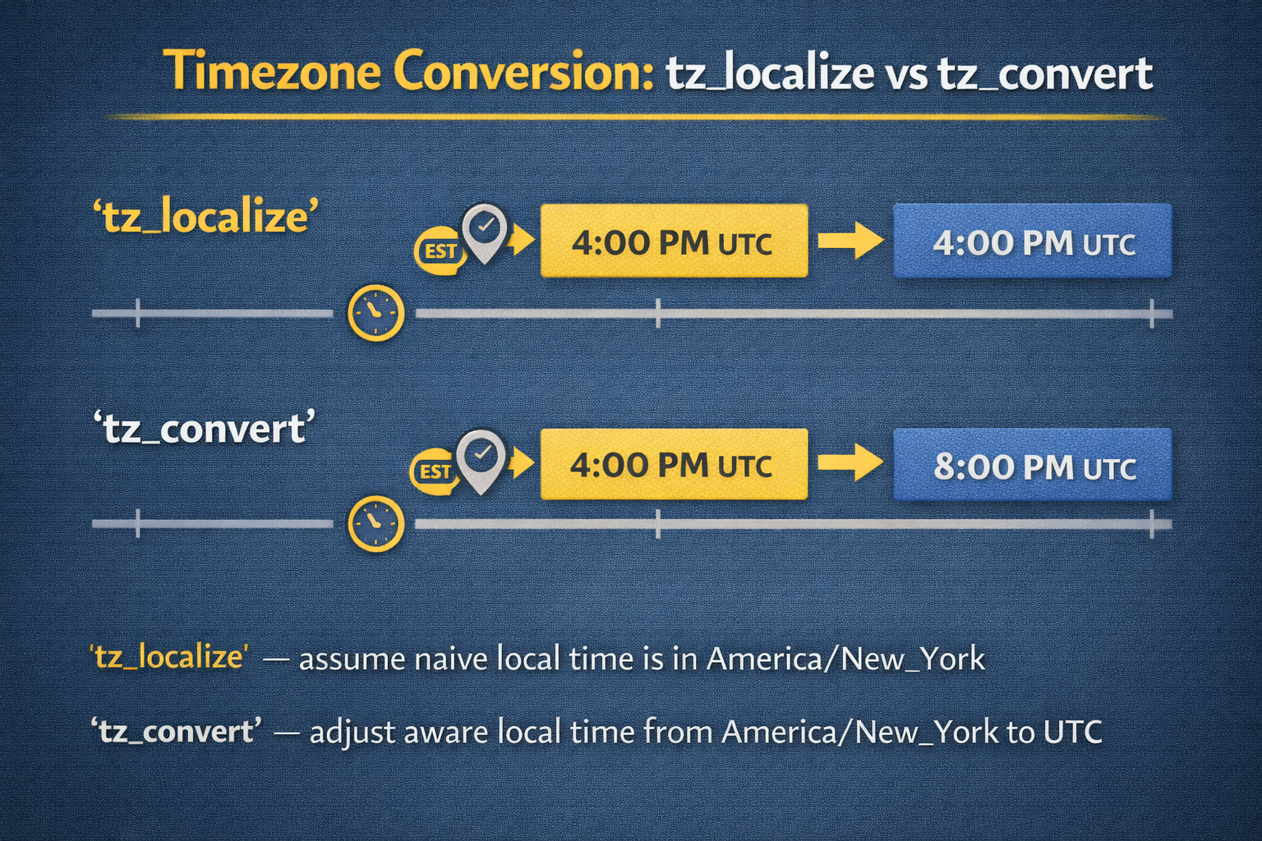
DAY 12 · STRING & DATE CLEANING
Time Zones, Localization, and Conversion
Naive vs aware datetimes for cross-region systems
Key Concepts
Pitfall
• Naive datetime: no time zone (tzinfo=None)
• Aware datetime: timezone-aware (tzinfo set)
• tz_localize: attach timezone to naive (interpretation)
• tz_convert: convert between zones (transformation)
Using naive timestamps from different regions as if same zone → incorrect comparisons and aggregations
LOCALIZING TO US/EASTERN AND CONVERTING TO UTC
df12["signup_dt_local"] = df12["signup_dt"].dt.tz_localize("US/Eastern", ambiguous="NaT", nonexistent="NaT")
df12["signup_dt_utc"] = df12["signup_dt_local"].dt.tz_convert("UTC")

Slide 19
DAY 12 · STRING & DATE CLEANING
Pitfalls of Naive Datetime Handling in ML
Silent errors in time-based features
Typical Mistakes
ML Impact
• Comparing timestamps from different zones directly
• Aggregating by hour without common reference
• Ignoring daylight saving transitions → duplicate/missing hours
• Misaligned features confuse models about daily/weekly cycles
• Fairness concerns if time zones correlate with demographics
DERIVING TIME-BASED FEATURES AFTER LOCALIZATION
df12["signup_hour_local"] = df12["signup_dt_local"].dt.hour
df12["signup_weekday_local"] = df12["signup_dt_local"].dt.dayofweek
print(df12[["signup_dt_local", "signup_hour_local", "signup_weekday_local"]].head())

Slide 20
DAY 12 · ACTIVITY & ASSESSMENT
String & Date Cleaning Practice
Clean city and datetime columns end-to-end
Activity Steps
Assessment
1. Load dataset with city names and timestamps
2. Strip whitespace, normalize case
3. Remove/normalize separators and special chars
4. Design variant → canonical mapping
5. Parse dates with errors='coerce'
6. Localize to relevant timezone, convert to UTC
7. Create derived features (hour, day of week)
Conceptual:
• Why can naive datetime parsing lead to biased model estimates?
• How might time zones interact with seasonality features?
Code: Implement standardize_city() and localize_and_convert()
SKELETON
df_users["city_clean"] = df_users["city"].str.strip().str.lower().str.replace("-", " ", regex=False)
df_users["signup_dt"] = pd.to_datetime(df_users["signup_time"], errors="coerce")
df_users["signup_dt_utc"] = df_users["signup_dt"].dt.tz_localize("US/Eastern").dt.tz_convert("UTC")

Slide 21
DAY 13
Large Dataset Cleaning
Chunking, Sampling, and Performance Optimization
OBJECTIVES
ACTIVITY
• Define 'large' in practical settings
• Use chunked reading (chunksize) for memory-constrained data
• Sample for iterative cleaning design
• Compare vectorized vs .apply() vs loops
• Measure and identify bottlenecks
Work with large dataset to identify and optimize slow steps.
ASSESSMENT
Written strategies for large datasets plus optimization code.
Week 3 · Data Cleaning II

Slide 22
DAY 13 · LARGE DATASETS
What Makes a Dataset 'Large' in Practice
Relative to available memory and latency requirements
Practical Criteria
Why Basic Cleaning Is Insufficient
• Dataset size approaches/exceeds available RAM
• End-to-end cleaning takes too long interactively
• Repeated reloads for experimentation are slow
• Many chained .assign() calls = expensive copies
• Python loops over rows (df.iterrows()) become prohibitive
• Must think about memory and compute together
ROUGH MEMORY ESTIMATE
import os
file_path = "large_users.csv"
size_bytes = os.path.getsize(file_path)
size_mb = size_bytes / (1024 * 1024)
print(f"File size: {size_mb:.2f} MB") # First indication of feasibility

Slide 23
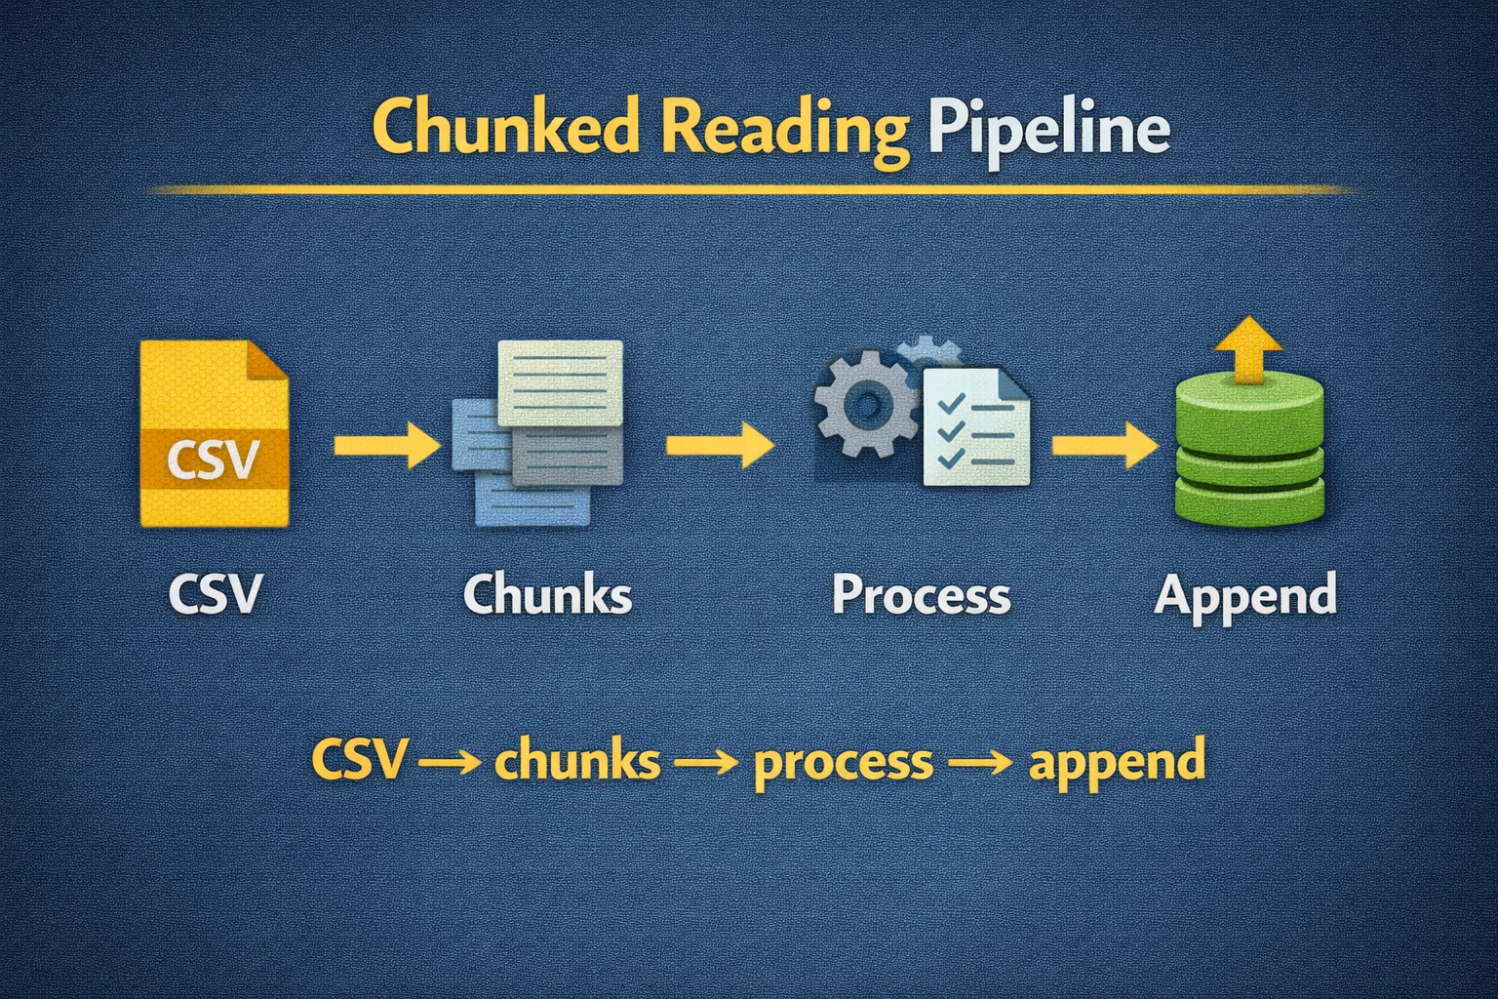
DAY 13 · LARGE DATASETS
Reading Data in Chunks with chunksize
Process large files in manageable pieces
Benefits
Trade-offs
• Memory usage bounded by chunk size
• Stream through data progressively
• Can compute aggregates incrementally
• More complex control flow (manual concatenation)
• Some operations need coordination across chunks (global deduplication, percentiles)
BASIC CHUNKED ITERATION
chunks = pd.read_csv("large_users.csv", chunksize=50_000)
total_rows, sum_income = 0, 0.0
for chunk in chunks:
total_rows += len(chunk)
sum_income += chunk["income"].sum()
mean_income = sum_income / total_rows

Slide 24
DAY 13 · LARGE DATASETS
Sampling for Iterative Cleaning Design
Iterate quickly on sample, then scale
Strategy
Risks
• Load random subset (e.g., 50,000 rows) for EDA
• Verify patterns hold across full dataset via per-chunk checks
• Only run full pipeline after logic is validated
• Non-random sampling (first N rows) may miss patterns
• Rare issues (categories, outliers) might not appear in small samples
RANDOM ROW SAMPLING DURING LOAD
sample_df = pd.read_csv("large_users.csv", nrows=50_000)
print(sample_df.head())
print(sample_df["city"].value_counts()) # Quick check of category distribution

Slide 25
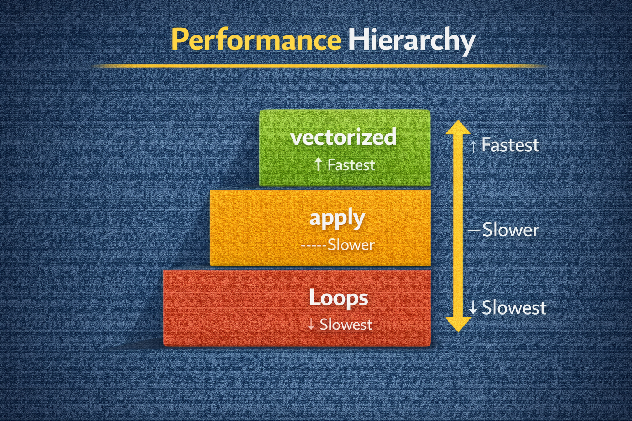
DAY 13 · LARGE DATASETS
Vectorization vs .apply() vs Explicit Loops
Understanding performance hierarchy
Performance Hierarchy
ML Impact
Best: Pure vectorized (df['x'] * 2, df['x'].clip())
Medium: .apply() with simple functions
Slowest: Row-wise .apply(axis=1) or for loops
Efficient cleaning → more experiments → better models
Inefficient cleaning may limit experimentation entirely
TIMING COMPARISON
%timeit sample["income_scaled_vec"] = sample["income"] / 1000.0 # Fast
%timeit sample["income_scaled_apply"] = sample["income"].apply(lambda x: x/1000) # Slower

Slide 26
DAY 13 · LARGE DATASETS
Avoiding Python Loops in Cleaning
Express transformations as column-wise operations
ANTI-PATTERN (AVOID)
RECOMMENDED PATTERN
clean_values = []
for _, row in sample_df.iterrows():
clean_values.append(row["income"] / 1000.0)
sample_df["income_scaled_loop"] = clean_values
# Column-wise operation
sample_df["income_scaled"] = sample_df["income"] / 1000.0
# Conditional without loops
sample_df["high_flag"] = (sample_df["income"] > threshold).astype(int)
Key Insight
Use .where, .mask, .clip, .fillna for conditional logic instead of row-by-row iteration. Keeps pipeline scalable and maintainable.

Slide 27
DAY 13 · LARGE DATASETS
Measuring Performance and Identifying Bottlenecks
Without measurement, optimization is guesswork
Approaches
Use Performance Data
• %timeit in interactive environments
• time.perf_counter() in scripts
• Profile memory via system tools or specialized libraries
• Guides whether to refactor or optimize
• Identifies if distributed solutions needed
• Prioritizes effort on actual bottlenecks
TIMING A CLEANING FUNCTION
import time
def clean_chunk(chunk): return chunk.copy()
start = time.perf_counter()
cleaned = clean_chunk(sample_df)
elapsed = time.perf_counter() - start
print(f"Chunk cleaned in {elapsed:.3f} seconds")

Slide 28
DAY 13 · ACTIVITY & ASSESSMENT
Large Dataset Practice
Chunked cleaning with performance measurement
Activity Steps
Assessment
1. Get CSV with 100K+ rows
2. Estimate file size, consider RAM
3. Design chunked cleaning loop
4. Apply cleaning to each chunk
5. Write cleaned chunks to new file
6. Measure runtime and memory
7. Compare with full-file approach
Short answer:
• Three strategies for datasets that don't fit in RAM?
• How does vectorization help performance?
Code: Implement process_large_file(path_in, path_out, chunksize)
CHUNKED CLEANING SKELETON
reader = pd.read_csv("large_users.csv", chunksize=50_000)
for i, chunk in enumerate(reader):
cleaned = clean_chunk(chunk)
mode, header = ("w", True) if i == 0 else ("a", False)
cleaned.to_csv("cleaned.csv", mode=mode, header=header, index=False)

Slide 29
DAY 14
Full Cleaning Pipeline
Modular Design, Order of Operations, Validation
OBJECTIVES
ACTIVITY
• Understand why pipelines are essential for ML
• Design function-based modular components
• Establish clear order of operations
• Integrate logging and validation
• Plan for pipeline failure points
Build and test a master clean_data() function.
ASSESSMENT
Code review focusing on clarity, documentation, reproducibility.
Week 3 · Data Cleaning II

Slide 30
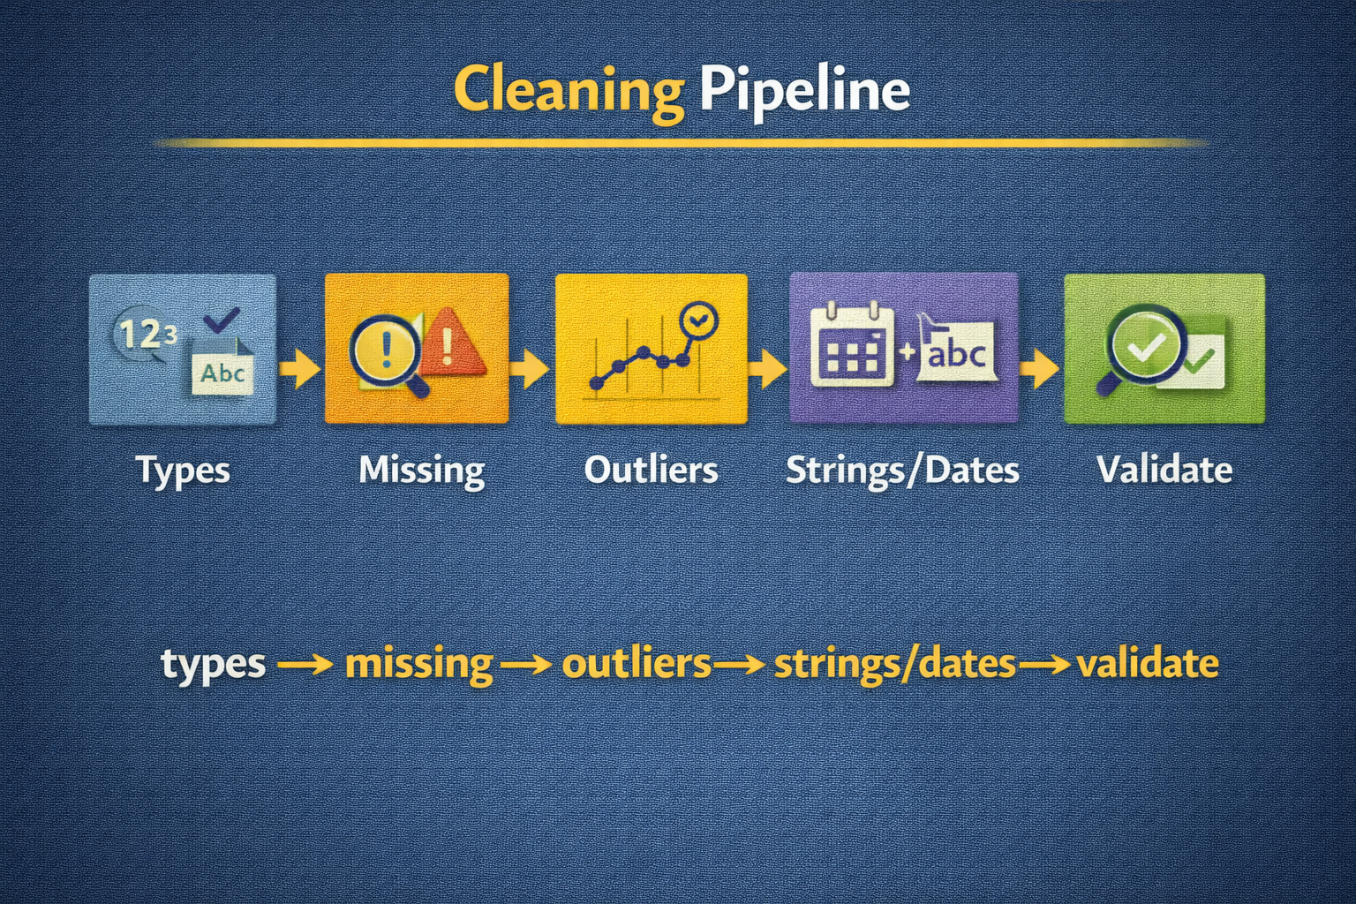
DAY 14 · CLEANING PIPELINE
Why Cleaning Pipelines Matter for ML
Ad hoc cleaning in notebooks is fragile
Benefits of Pipelines
Problems with Ad Hoc Cleaning
• Reproducibility: same raw data → same cleaned data
• Debuggability: trace problems to specific steps
• Deployment: same logic in batch and online systems
• Hidden state across notebook cells
• Hard to re-run exactly after changes
• Difficult for team to understand/trust
SIMPLE PIPELINE SHAPE
def clean_data(df: pd.DataFrame) -> pd.DataFrame:
df = df.copy()
df = clean_types(df)
df = clean_missing(df)
df = handle_outliers(df)
df = clean_strings_and_dates(df)
validate_cleaned(df)
return df

Slide 31
DAY 14 · CLEANING PIPELINE
Function-Based Cleaning and Modular Design
Single responsibility per function promotes testability
Design Principles
EXAMPLE HELPER FUNCTIONS
• Single responsibility per function
• Clear input/output contracts (DataFrame in/out)
• No hidden global state
• Each function independently testable
def clean_types(df):
out = df.copy()
out["age"] = pd.to_numeric(out["age"], errors="coerce")
out["income"] = pd.to_numeric(out["income"], errors="coerce")
return out
def clean_missing(df):
out = df.copy()
out["age"] = out["age"].fillna(out["age"].median())
return out
Each function is reusable across projects and easily unit-tested.

Slide 32
DAY 14 · CLEANING PIPELINE
Order of Operations and Pipeline Stability
Transformation order has major implications
Recommended Order
Why Order Matters
1. Type normalization (numeric, categorical, datetime)
2. Missing-value handling (imputation, indicators)
3. Outlier handling (capping, transformation)
4. String and category cleaning
5. Date/time feature extraction
• Outlier detection on wrong types = meaningless
• Imputation before type conversion hides errors
• Date features from misparsed timestamps = wrong
Change order deliberately and document!
INTEGRATING ORDER INTO clean_data()
def clean_data(df):
df = clean_types(df) # 1. Types first
df = clean_missing(df) # 2. Then missing values
df = handle_outliers(df) # 3. Then outliers
df = clean_strings_and_dates(df) # 4. Then strings/dates
df = add_features(df) # 5. Finally derived features
return df

Slide 33
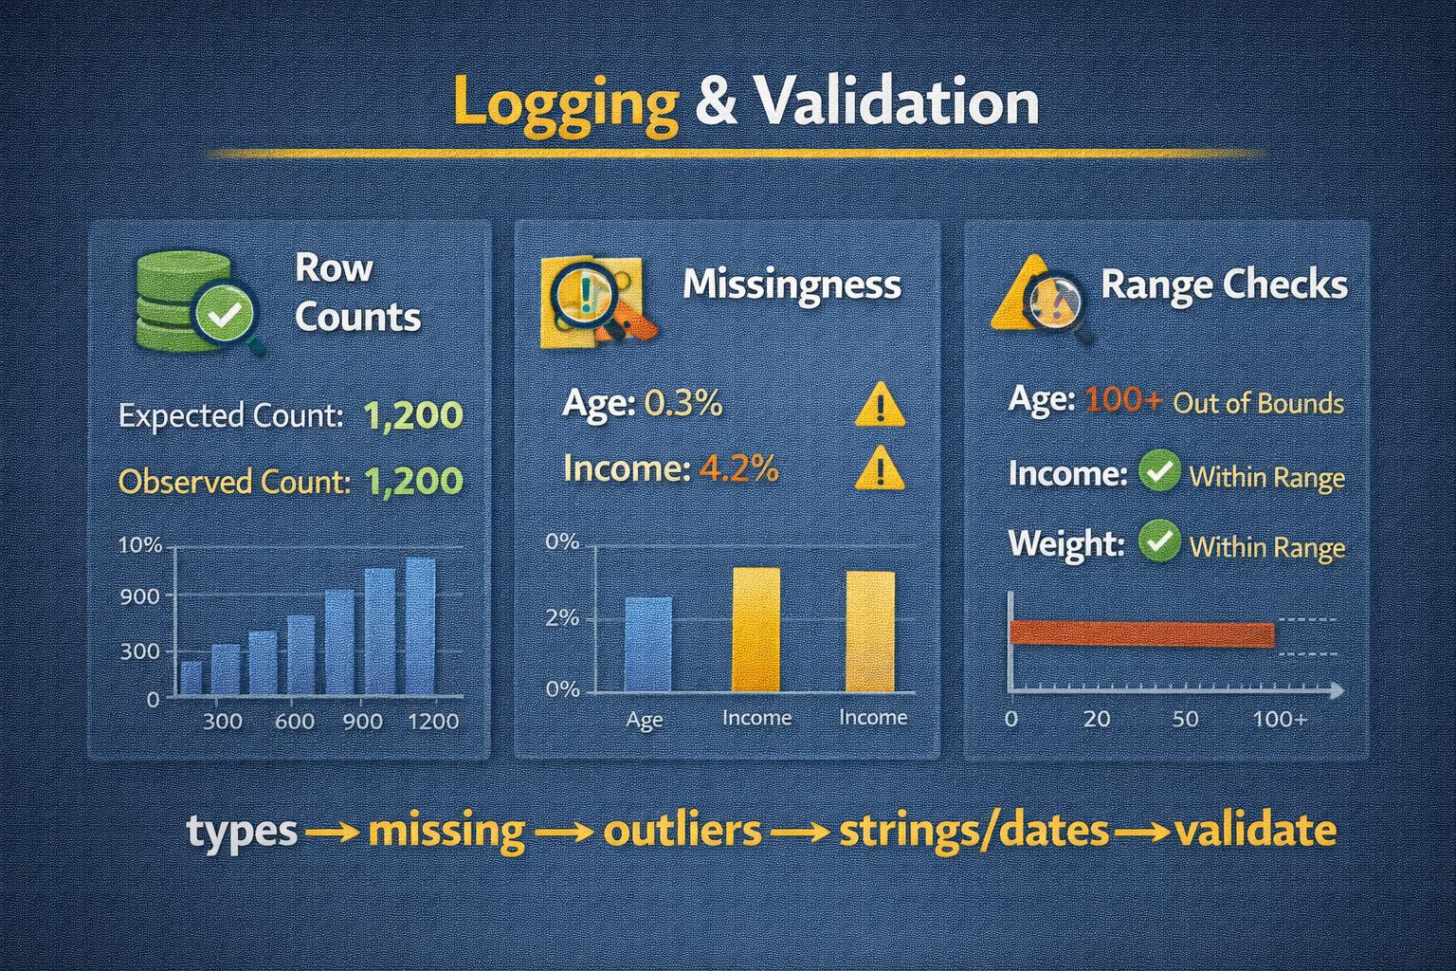
DAY 14 · CLEANING PIPELINE
Logging and Basic Validation
Catch anomalies early, ensure expected behavior
Logging
Validation
• Record row counts, missingness summary
• Log outlier thresholds used
• Store logs with pipeline runs for auditability
• Assert key invariants (no negative ages)
• Check ranges and category memberships
• Verify required columns present
LOGGING/VALIDATION PATTERNS
def validate_cleaned(df):
assert df["age"].min() >= 0, "Negative ages found"
assert df["income"].notna().all(), "Income still has NaN"
def log_summary(df, step_name):
print(f"--- {step_name} ---\nRows: {len(df)}\nMissing age: {df['age'].isna().sum()}")

Slide 34
DAY 14 · CLEANING PIPELINE
Pipeline Failure Points and Error Handling
Anticipate and handle unexpected data gracefully
Common Failure Points
Error-Handling Strategies
• Unexpected types (all strings where numbers expected)
• New categories not covered by mapping
• Invalid dates (impossible calendar dates)
• Schema changes from upstream systems
• Fail fast with clear error messages
• Route problematic records to quarantine table
• Log frequencies of errors for prioritization
SAFE TYPE CONVERSION WITH ERROR LOGGING
def safe_to_numeric(s, col_name):
converted = pd.to_numeric(s, errors="coerce")
n_invalid = converted.isna().sum() - s.isna().sum()
if n_invalid > 0: print(f"[WARN] {n_invalid} invalid in {col_name}")
return converted

Slide 35
DAY 14 · ACTIVITY & ASSESSMENT
Pipeline Building Practice
Build master clean_data() function
Activity Steps
Assessment
1. Choose realistic raw dataset
2. Design clean_data() pipeline that:
- Normalizes types
- Handles missing with indicators
- Caps/transforms outliers
- Cleans text and parses dates
3. Integrate logging and validation
4. Run end-to-end and inspect results
Review questions:
• How verify pipeline is deterministic?
• How adapt for daily batch processing?
• How unit-test individual functions?
Submit pipeline code + written rationale.
SKELETON
def clean_strings_and_dates(df):
out = df.copy()
out["city"] = out["city"].str.strip().str.lower()
out["signup_time"] = pd.to_datetime(out["signup_time"], errors="coerce").dt.tz_localize("UTC")
return out

Slide 36
DAY 15
Mini Project
Clean a Real Dataset End-to-End
OBJECTIVES
ACTIVITY
• Apply all Week 3 techniques in realistic context
• Document cleaning decisions and rationale
• Produce analysis-ready dataset
• Make realistic trade-offs (drop vs impute, cap vs transform)
Clean raw dataset end-to-end, from ingestion to final feature table.
ASSESSMENT
GitHub submission with code, cleaned data, and documentation.
Week 3 · Data Cleaning II

Slide 37
DAY 15 · MINI PROJECT
Selecting and Inspecting a Real Dataset
First step: understand structure and problems
Dataset Requirements
Initial Inspection
• Numeric variables likely to have outliers
• Text/categorical fields (cities, product names)
• Date/time fields (ideally with timezone considerations)
• Sufficient size to make performance non-trivial
• Load small sample to inspect columns, dtypes
• Identify likely targets for outlier strategies
• Identify string cleaning and date handling needs
INITIAL SAMPLING AND INSPECTION
df_raw = pd.read_csv("real_dataset.csv")
print(df_raw.head())
print(df_raw.info())
print(df_raw.nunique().sort_values(ascending=False).head(10))

Slide 38
DAY 15 · MINI PROJECT
Designing an End-to-End Cleaning Plan
Outline steps before writing code
Plan Components
ML Considerations
• Identify key target and predictor variables
• Decide type conversions and expected dtypes
• Specify missing-value strategies per column
• Decide outlier strategies (percentile capping)
• Outline text and date cleaning requirements
• Which features matter most for modeling?
• Clean critical features most carefully
• Consider fairness/bias for demographic fields
PLAN AS METADATA DICTIONARY
cleaning_plan = {
"age": {"type": "float", "missing": "median_imp", "outliers": "cap_99"},
"income": {"type": "float", "missing": "median_imp", "outliers": "log1p_cap_99"},
"city": {"type": "category", "clean": "canonical_city"},
"signup_time": {"type": "datetime", "tz": "UTC"}
}

Slide 39
DAY 15 · MINI PROJECT
Implementing the Project Cleaning Pipeline
Core function: raw data → cleaned DataFrame
Requirements
PROJECT-LEVEL clean_data
• Incorporate type conversion, missing values, outliers, strings, dates
• Use vectorized operations where possible
• Include logging summarizing key changes
def clean_data_project(df_raw):
df = df_raw.copy()
# Types
df["age"] = pd.to_numeric(df["age"], errors="coerce")
df["income"] = pd.to_numeric(df["income"], errors="coerce")
df["signup_time"] = pd.to_datetime(df["signup_time"], errors="coerce")
# Missing
df["age_missing"] = df["age"].isna().astype(int)
df["age"] = df["age"].fillna(df["age"].median())
df["income_missing"] = df["income"].isna().astype(int)
df["income"] = df["income"].fillna(df["income"].median())
# Outliers
df["income"] = df["income"].clip(upper=df["income"].quantile(0.99))
# Strings and dates
df["city"] = df["city"].str.strip().str.lower()
df["signup_time"] = df["signup_time"].dt.tz_localize("UTC")
return df
Starting point - refine with dataset-specific logic.

Slide 40
DAY 15 · MINI PROJECT
Documenting Cleaning Decisions and Rationale
Explain not just what, but why
Key Elements
ML Impact
For each transformation:
• What problem it addresses
• Why you chose that strategy over alternatives
• Potential risks or downsides
• Assumptions about data-generating process
Explain how cleaning choices expected to affect:
• Model performance
• Fairness and bias
• Generalization to new data
DECISION LOG STRUCTURE
cleaning_decisions = {
"income_cap_99": "Cap income at 99th percentile to reduce influence of extreme values while keeping all records.",
"age_median_imp": "Impute missing age with global median; less sensitive to outliers than mean."
}

Slide 41
DAY 15 · MINI PROJECT
Verifying Correctness and Producing Analysis-Ready Dataset
Validate before using for modeling
Verification Steps
When Checks Pass
• Check dtypes of all key columns
• Inspect summary stats (min, max, mean, percentiles)
• Inspect category distributions for text fields
• Verify datetimes are timezone-aware
• Confirm no unexpected NaN in critical columns
Dataset is ready for downstream analysis or modeling
Save cleaned version (CSV or Parquet) for reproducibility
BASIC VERIFICATION
df_clean = clean_data_project(df_raw)
print(df_clean.info())
print(df_clean[["age", "income"]].describe())
print(df_clean["city"].value_counts().head())
print(df_clean["signup_time"].dt.tz)

Slide 42
DAY 15 · MINI PROJECT
Full Dataset Cleaning Submission
Integrate all Week 3 techniques
Activity Instructions
Submission Requirements
1. Select real dataset (public or provided)
2. Design and implement clean_data_project()
3. Run pipeline, generate cleaned dataset
4. Save as CSV or Parquet
5. Prepare documentation:
- Dataset and its issues
- All cleaning steps with rationales
- Trade-offs and limitations
GitHub repository containing:
• Raw dataset or pointer to it
• Cleaning code with clean_data_project()
• Cleaned dataset file
• README/report explaining decisions and risks
This integrates all Week 3 into production workflow.

Slide 43
Week 3 Complete!
Data Cleaning II — Production-Ready Skills
Outlier Strategies
Capping (winsorization), flooring, removal; model sensitivity; when NOT to remove
String & Date Cleaning
Whitespace/case normalization, canonical mappings, datetime parsing, time zones
Large Datasets
Chunked reading, sampling for design, vectorization over loops, performance measurement
Full Pipeline
Modular design, order of operations (types→missing→outliers→strings→dates), logging, validation
Mini Project
End-to-end cleaning with documentation, verification, and analysis-ready output
Key Takeaway
Production data cleaning requires explicit strategies, documented rationale, and validation. Every decision affects model performance, fairness, and reproducibility.
clean_data(df) → clean_types() → clean_missing() → handle_outliers() → clean_strings_and_dates() → validate() → ✓

